Slide 1
Qualifications
for Data Analyst
in California
Aoran Zhang
Yi Meng
Xiaofei Li
University of California Davis

Slide 2


Motivation
1．
2．
3．

Slide 3
Project Procedure
1．
2．
3．
4．

Slide 4
Skills Requirements
Web
Scrapping
Basic
Requirements
Data source and cleaning

Slide 5
Skills Requirements
Web
Scrapping
Basic
Requirements
Map

Slide 6
Skills Requirements
Web
Scrapping
Basic
Requirements
Education Background Requirements

Slide 7
Skills Requirements
Web
Scrapping
Basic
Requirements
Working Experience Requirements

Slide 8

Skills Requirements
Web
Scrapping
Basic
Requirements
Natural Language Processing
Stem
lemmatize
lDF Calculation

Slide 9
Skills Requirements
Web
Scrapping
Basic
Requirements
Word cloud

Slide 10
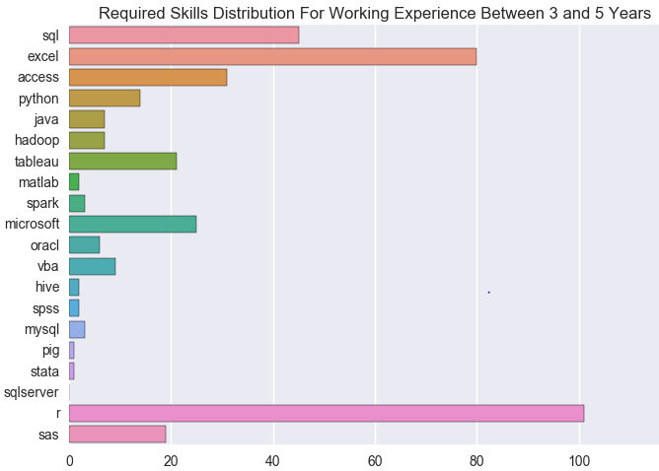
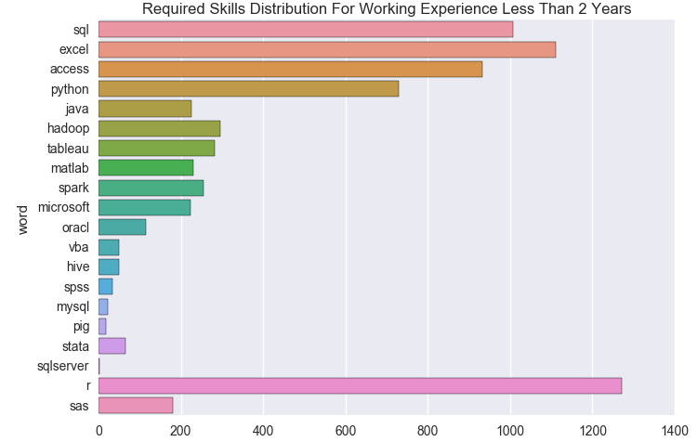
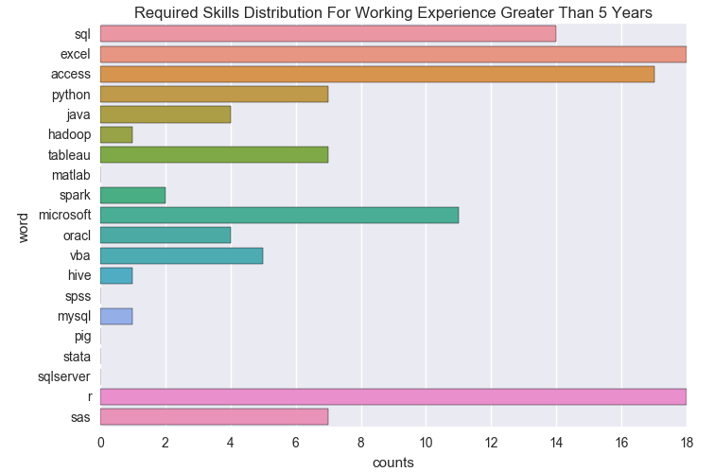
Skills Requirements vs Working Experience
Web
Scrapping

Slide 11
Skills Requirements vs Education Background
Web
Scrapping

Slide 12

Method
Generalization

Slide 13

Method Generalization
毕业生就业更倾向北上广等一线城市
专业因素影响毕业生选择就业城市
毕业生对“大学生留汉工程”关注度较低
城市收入水平，建设水平，行业发展前景对毕业生选择就业城市有一定影响

Slide 14
Aoran Zhang Yi Meng Xiaofei Li
Thank you!
University of California, Davis

